Slide 1
CSE 304
Design & Analysis of Algorithm
Lecture 3
DFS (Revisited) & Topological Sort

Slide 2

DFS(V, E)
1. for each u ∈ V
u
v
w
2.
3.
do color[u] ← WHITE
prev[u] ← NIL
x
y
z
time ← 0
for each u ∈ V
6.
7.
do if color[u] = WHITE
then DFS-VISIT(u)
Every time DFS-VISIT(u) is called, u becomes the root of a new tree in the depth-first forest

Slide 3
DFS-VISIT(u)
color[u] ← GRAY
time ← time+1
d[u] ← time
for each v ∈ Adj[u]
u
v
w
x y
z
time = 1
u v
1/
5.
6.
7.
do if color[v] = WHITE
then prev[v] ← u
DFS-VISIT(v)
w
x u
1/
y v
2/
z w
color[u] ← BLACK
time ← time + 1
f[u] ← time
x
y
z

Slide 4
Example
u
1/
u
1/
v w
2/
u
1/
v
2/
v
w
w
3/
y
x
y
z
x
y
z
x
z
u
1/
v
2/
u
1/
v
2/
u
1/
v
2/
w
w
w
B
B
4/
x
3/
y
4/
x
3/
y
4/5
x
3/
y
z
z
z
u
1/
v
2/
u
1/
v
2/7
u
1/ F
4/5
x
v
2/7
w
w
w
B
B
B
4/5
x
3/6
y
4/5
x
3/6
y
3/6
y
z
z
z

Slide 5
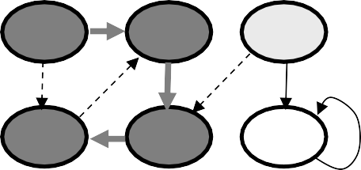
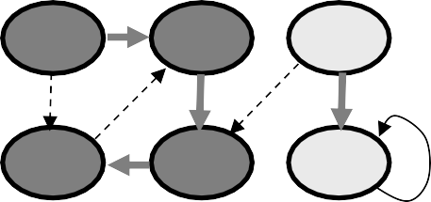
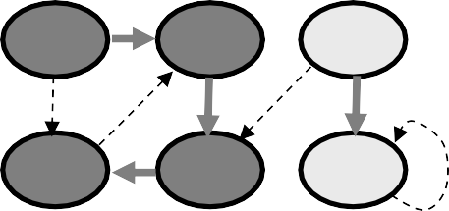
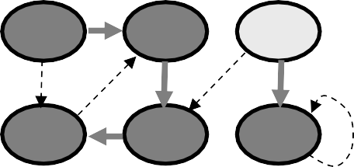
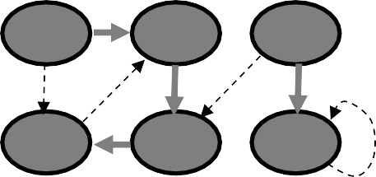
Example (cont.)
u
1/8
F
4/5
x
v
2/7
u
1/8
F
4/5
x
v
2/7
w
9/
u
1/8
F
4/5
x
v
2/7
w
9/
w
B
B
C
B
3/6
y
3/6
y
3/6
y
z
z
z
u
1/8
v
2/7
w
9/
u
1/8
v
2/7
w
9/
u
1/8
v
2/7
w
9/
C
C
C
F | B |  |  | F B |  |  |  | B | F B |  | B
4/5 | 3/6 |  | 10/ | 4/5 |  | 3/6 | 10/ |  | 4/5 | 3/6 | 10/11
x | y |  | z | x |  | y | z |  | x | y | z
u |  | v | w |  | The results of DFS may depend on:
1/8 F | B | 2/7 | 9/12 C | B | The order in which nodes are explored in procedure DFS
4/5 |  | 3/6 | 10/11 |  | The order in which the neighbors of a
x |  | y | z |  | vertex are visited in DFS-VISIT

Slide 6
Edge Classification
Tree edge (reaches a WHITE
vertex):
– (u, v) is a tree edge if v was first
discovered by exploring edge (u, v)
u
1/
v
w
x
y
z
Back edge (reaches a GRAY vertex):
(u, v), connecting a vertex u to an ancestor v in a depth first tree
Self loops (in directed graphs) are also back edges
u
1/
v
2/
w
B
4/
x
3/
y
z

Slide 7

Edge Classification
Forward edge (reaches a BLACK
vertex & d[u] < d[v]):
– Non-tree edges (u, v) that connect a vertex
u to a descendant v in a depth first tree
u
1/ F
4/5
x
v
2/7
w
B
3/6
y
z
Cross edge (reaches a BLACK vertex & d[u] > d[v]):
– Can go between vertices in same depth-first tree (as long as there is no ancestor / descendant relation) or between different depth-first trees
u
1/8
F
4/5
x
v
2/7
w
9/
B
C
3/6
y
z

Slide 8
Analysis of DFS(V, E)
1. for each u ∈ V
2.
3.
do color[u] ← WHITE
π[u] ← NIL
Θ(V)
time ← 0
for each u ∈ V
Θ(V) – exclusive of time for
DFS-VISIT
6.
7.
do if color[u] = WHITE
then DFS-VISIT(u)

Slide 9
Analysis of DFS-VISIT(u)
color[u] ← GRAY
time ← time+1
d[u] ← time
for each v ∈ Adj[u]
DFS-VISIT is called exactly
once for each vertex
5.
6.
7.
do if color[v] = WHITE
then π[v] ← u
DFS-VISIT(v)
Each loop takes
|Adj[v]|
color[u] ← BLACK
time ← time + 1
f[u] ← time
Total: Σ_{v∈V} |Adj[v]| + Θ(V) = Θ(V + E)
Θ(E)

Slide 10
Properties of DFS
u = prev[v] ⇔ DFS-VISIT(v) was called during a search of u’s adjacency list
u
1/
v
2/
w
3/
y
Vertex v is a descendant of vertex u in the depth first forest ⇔ v is discovered during the time in which u is gray
x
z

Slide 11
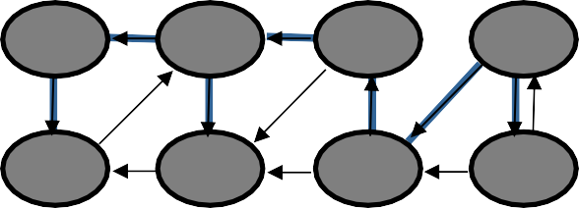
Parenthesis Theorem
y
3/6
z
2/9
s
1/10
t
11/16
In any DFS of a graph G, for all u, v, exactly one of the following holds:
4/5
x
7/8
w
12/13 14/15
v u
[d[u], f[u]] and [d[v], f[v]] are disjoint, and neither of u and v is a descendant of the other
[d[v], f[v]] is entirely within [d[u], f[u]] and v is a descendant of u
[d[u], f[u]] is entirely within [d[v], f[v]] and u is a descendant of v
s
t
z
v
u
y
w
x
1 2 3 4 5 6 7 8 9 10 11 12 13 14 15 16
(s (z (y (x x) y) (w w) z) s) (t (v u) (u u) t)
Well-formed expression: parenthesis are properly nested

Slide 12
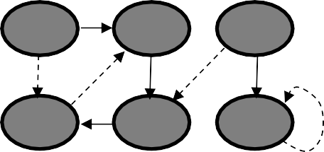
Other Properties of DFS
Corollary
Vertex v is a proper descendant of u
⇔ d[u] < d[v] < f[v] < f[u]
u
2/7
1/8
F
4/5
v
9/12
B
C
B
3/6
10/11
Theorem (White-path Theorem)
In a depth-first forest of a graph G, vertex v is a descendant of u if and only if at time d[u], there is a path u  v consisting of only white vertices.
u
2/
1/
v

Slide 13
Directed Acyclic Graph
DAG – Directed graph with no cycles.
Good for modeling processes and structures that have a partial order:
a > b and b > c ⇒ a > c.
But may have a and b such that neither a > b nor b > a.
Can always make a total order (either a > b or b
> a for all a ≠ b) from a partial order.

Slide 14

Characterizing a DAG
Lemma 22.11
A directed graph G is acyclic iff a DFS of G yields no back edges.
T
T
T
v
u
B

Slide 15
Topological Sort
Topological sort of a directed acyclic graph G = (V, E): a linear order of vertices such that if there exists an edge (u, v), then u appears before v in the ordering.
Directed acyclic graphs (DAGs)
– Used to represent precedence of events or processes that have a partial order
a before b
b before c
b before c
a before c
What about
a and b?
a before c
Topological sort helps us establish a total order

Slide 16
Topological Sort
Want to “sort” a directed acyclic graph (DAG).
A
B
D
C
E
A
B
C
D
E
Think of original DAG as a partial order.
Want a total order that extends this partial order.

Slide 17
Topological Sort - Application
Application 1
in scheduling a sequence of jobs.
The jobs are represented by vertices,
there is an edge from x to y if job x must be
completed before job y can be done
(for example, washing machine must finish before we put the clothes to dry). Then, a topological sort gives an order in which to perform the jobs
Application 2
In open credit system, how to take courses (in order) such that, pre-requisite of courses will not create any problem

Slide 18
Topological Sort (Fig – Cormen)
undershorts
11/ 16
17/18
socks
TOPOLOGICAL-SORT(V, E)
Call DFS(V, E) to compute finishing times f[v] for each vertex v
When each vertex is finished, insert it onto the front of a linked list
Return the linked list of
vertices
12/15
pants
shoes
13/14
shirt
1/8
6/7
belt
watch
9/10
tie
2/5
jacket 3/4
socks
undershorts
pants
shoes
watch shirt belt tie jacket
Running time: Θ(V + E)

Slide 19
Readings
Cormen - Chapter 22
Exercise:
22.4-2 : Number of paths (important)
22.4-3 : cycle (important and we have already solved
it)
22.4-5 : Topological sort using degree

